Slide 1
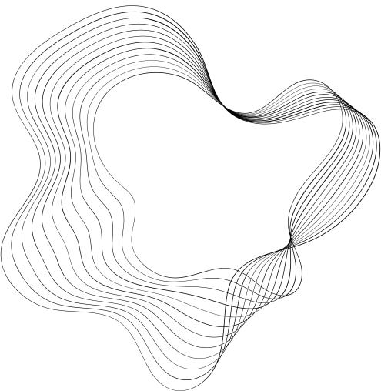

ALLYHUB
A Platform for Developers & Clients

Slide 2

Contents
01
Actors
02
Use Case Diagram
03
Use Case Description
04
Conclusion
5/29/2024
A202
2

Slide 3



Actors
Primary Actors
Client
Developers
Primary Actors
Admins

Slide 4
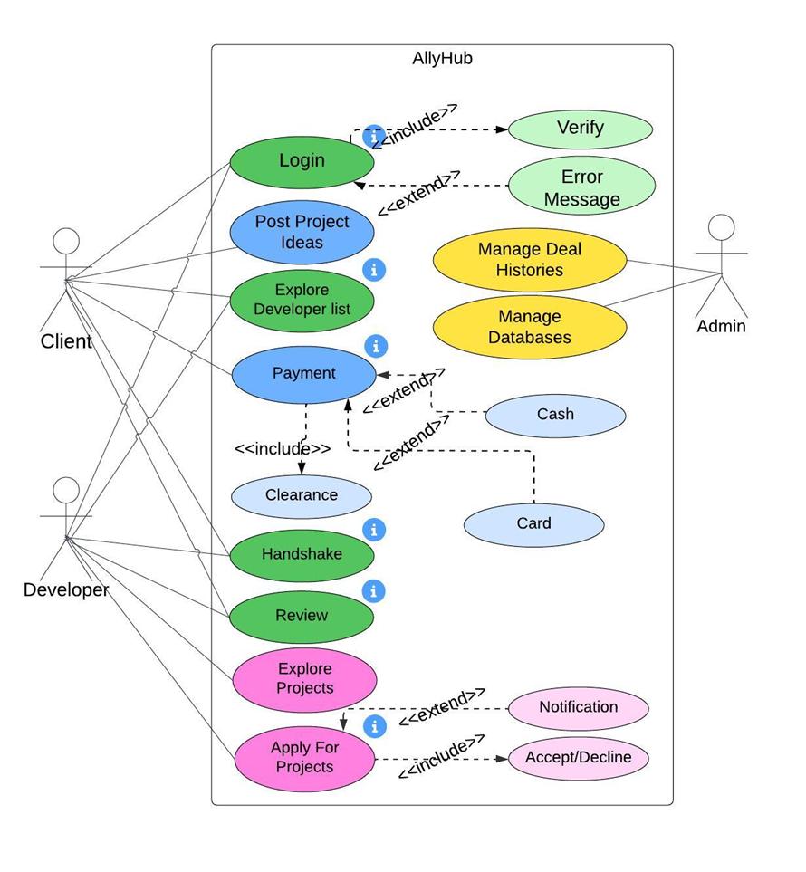
Use Case Diagram

Slide 5


Use Case Description
Login / Signup
Actors: Clients, Developers
Description: Actors sign up and log in to access features.
Precondition: Must have an account.
Priority: High
Exceptions: Includes verification and error messages if login fails.
CUSTOMERS

Slide 6

Use Case Description
Project Proposal
Actor: Client
Description: Clients post project ideas for developers to review.
Precondition: Client must be logged in.
Priority: Medium
Exceptions: None

Slide 7


Use Case Description
Developers List
Actor: Client
Description: Clients search for developers by skills and interests.
Precondition: Client must be logged in.
Priority: Medium
Exceptions: None
CUSTOMERS

Slide 8

Use Case Description
Payment
Actor: Client
Description: Clients pay developers upon project completion.
Precondition: Client and developer must be in a deal, client must be logged in.
Priority: High
Exceptions: Includes cash/card payment options and clearance notification.
CUSTOMERS

Slide 9

Use Case Description
Handshaking
Actors: Clients, Developers
Description: Initiates and confirms project deals.
Precondition: Both actors must be logged in.
Priority: High
Exceptions: None
CUSTOMERS

Slide 10

Use Case Description
Reviews
Actors: Clients, Developers
Description: Share experiences and feedback on project collaboration.
Precondition: Both actors must be logged in.
Priority: Low
Exceptions: None
CUSTOMERS

Slide 11

Use Case Description
Explore Projects
Actor: Developer
Description: Developers search for projects to work on.
Precondition: Developer must be logged in.
Priority: Low
Exceptions: None

Slide 12


Use Case Description
Apply For Projects
Actor: Developer
Description: Developers apply for project collaborations.
Precondition: Developer must be logged in.
Priority: High
Exceptions: Includes acceptance/declination and notification of application status.

Slide 13

Use Case Description
Manage Deal Histories
Actor: Admin
Description: Admins manage records of project deals.
Precondition: Admin must have backend access.
Priority: High
Exceptions: None

Slide 14

Use Case Description
Manage Database
Actor: Admin
Description: Admins update and maintain the database.
Precondition: Admin must have access to SQL queries.
Priority: High
Exceptions: None

Slide 15
Use Case Description
Manage Database
Actor: Admin
Description: Admins update and maintain the database.
Precondition: Admin must have access to SQL queries.
Priority: High
Exceptions: None

Slide 16

Conclusion
AllyHub aims to improve user experience by introducing new features, implementing AI for improved matchmaking, enhancing security measures, venturing into additional industries, and ensuring the platform remains up-to-date through regular updates.
Future Outlook
The interactions for Clients, Developers, and Admins are outlined in the use-case diagram for AllyHub. It details responsibilities such as creating projects, submitting job applications, and processing payments, guaranteeing smooth system functioning and user contentment.
Summary

Slide 17

THANK YOU
Any Queries?

